Slide 1
CSCI 104 Queues and Stacks
Mark Redekopp
David Kempe
Sandra Batista
Aaron Cote’

Slide 2
Stacks & Queues
Lists are good for storing generic sequences of items, but they can be specialized to form other useful structures
What if we had a List, but we restricted how insertion and removal were done?
Stack – Only ever insert/remove from one end of the list
Queue – Only ever insert at one end and remove from the other

Slide 3
Queue ADT
Queue – A list of items where insertion only occurs at the back of the list and removal only occurs at the front of the list
Like waiting in line for a cashier at a store
Queues are FIFO (First In, First Out)
Items at the back of the queue are the newest
Items at the front of the queue are the oldest
Elements are processed in the order they arrive

Slide 4

A Queue Visual
Items leave from the front
(pop_front)
Items enter at the back
(push_back)
(pop_front)
(push_back)

Slide 5
Queue Operations
What member functions does a Queue have?
push_back(item) – Add an item to the back of the Queue
pop_front() - Remove the front item from the Queue
front() - Get a reference to the front item of the Queue (don't remove it though!)
size() - Number of items in the Queue
empty() - Check if the Queue is empty
(push_back)
(pop_front)

Slide 6
A Queue Class
A sample class interface for a Queue
Queue Error Conditions
Queue Underflow – The name for the condition where you call pop on an empty Queue
Queue Overflow – The name for the condition where you call push on a full Queue (a Queue that can't grow any more)
This is only possible for Queues that are backed by a bounded list
#ifndef QUEUEINT_H #define QUEUEINT_H
class QueueInt {
public:
QueueInt();
~QueueInt();
size_t size() const;
// enqueue
void push_back(const int& value);
// dequeue
void pop_front(); // dequeue
int const & front() const;
bool empty() const;
private:
// ???
};
#endif

Slide 7
Other Queue Details
How should you implement a Queue?
Compose using an ArrayList
Compose using a singly-linked list w/o a tail pointer
Compose using a singly-linked list w/ a tail pointer
Which is best?
 | Push_back | Pop_front | Front()
ArrayList
LinkedList (Singly-linked w/o tail ptr)
LinkedList (Singly-linked w/ tail ptr)

Slide 8
Other Queue Details
How should you implement a Queue?
Compose using an ArrayList
Compose using a singly-linked list w/o a tail pointer
Compose using a singly-linked list w/ a tail pointer
Which is best?
 | Push_back | Pop_front | Front()
ArrayList | O(1) | O(n) | O(1)
LinkedList (Singly-linked w/o tail ptr) | O(n) | O(1) | O(1)
LinkedList (Singly-linked w/ tail ptr) | O(1) | O(1) | O(1)

Slide 9
Queue Applications
Print Jobs
Click “Print” on the computer is much faster than actually printing (build a backlog)
Each job is processed in the order it's received (FIFO)
Why would you want a print queue rather than a print stack
Seating customers at a restaurant
Anything that involves "waiting in line"
Helpful to decouple producers and consumers

Slide 10
Stack ADT
Stack: A list of items where insertion and removal only occurs at one end of the list
Examples:
A stack of boxes where you have to move the top one to get to ones farther down
A spring-loaded plate dispenser at a buffet
A PEZ dispenser
Your e-mail inbox
Stacks are LIFO
Newest item at top
Oldest item at bottom
(push)
(pop)
Top item
Stack

Slide 11
Stack Operations
What member functions does a Stack have?
push(item) – Add an item to the top of the Stack
pop() - Remove the top item from the Stack
top() - Get a reference to the top item on the Stack (don't remove it though!)
size() - Get the number of items in the Stack
What member data does a Stack have?
A list of items
Top/Last Item Pointer/Index
(push)
(pop)
Top item
Top/Last Item
Stack

Slide 12
Stack Axioms
For all stacks, s:
s.push(item).top() = item
s.push(item).pop() = s
Let’s draw the stack for these operations:
s.push(5).push(4).pop().top()
(push)
(pop)
Top item
Stack

Slide 13
A Stack Class
A sample class interface for a Stack
How should you implement a Stack?
Back it with an array
Back it with a linked list
Which is best?
Stack Error Conditions
Stack Underflow – The name for the condition where you call pop on an empty Stack
Stack Overflow – The name for the condition where you call push on a full Stack (a stack that can't grow any more)
#ifndef STACKINT_H
#define STACKINT_H
class StackInt {
public:
StackInt();
~StackInt();
size_t size() const;
bool empty() const;
void push(const int& value);
void pop();
int const & top() const;
}; #endif

Slide 14
Array Based Stack
A sample class interface for a Stack
If using an array list, which end should you use as the "top"?
Front or back?
If using a linked list, which end should you use?
If you just use a head pointer only?
If you have a head and tail pointer?
#ifndef STACKINT_H #define STACKINT_H
class StackInt {
public:
StackInt();
~StackInt();
size_t size() const;
bool empty() const;
void push(const int& value);
void pop();
int const& top() const;
private:
AListInt mylist_;
// or LListInt mylist_;
};
#endif

Slide 15
Stack Examples
#include <iostream> #include <string> #include "stack.h" using namespace std; int main() {
StackChar s;
string word;
cout << "Enter a word: ";
getline(cin,word);
for(int i=0; i < word.size(); i++)
s.push(word.at(i));
while(!s.empty()){
cout << s.top();
s.pop();
}
}
Reverse a string
Type in: "hello"
Output: "olleh"

Slide 16
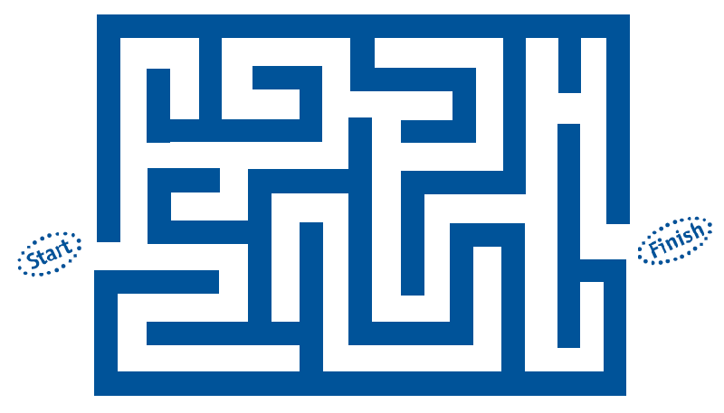
Another Stack Example
Depth First Search
Use a stack whenever you encounter a decision, just pick and push decision onto stack. If you hit a dead end pop off last decision (retrace steps) and keep trying, etc.
Assume we always choose S, then L, then R
Straight or Left
Choose straight…dead end
Pop straight and make next choice…left
Next decision is Straight or Right…choose Straight…
http://www.pbs.org/wgbh/nova/einstein/images/lrk-maze.gif

Slide 17
Stack Usage Example
Check whether an expression is properly parenthesized with '(', '[', '{', '}', ']', ')'
Correct: (7 * [8 + [9/{5-2}]])
Incorrect: (7*8
Incorrect: (7*8]
Note: The last parentheses started should be the first one completed
Approach
Scan character by character of the expression string
Each time you hit an open-paren: '(', '[', '{' push it on the stack
When you encounter a ')', ']', '}' the top character on the stack should be the matching opening paren type, otherwise ERROR!
(7 * [8 + [9/{5-2}]])
(
[
[
{
}
]
]
)
{
[
[
(
(7 * [4 + 2 + 3])
3
3
9
5
+
63
9
2
+
4
[
9
*
*
7
7
(
(
63

Slide 18
Queue with two stacks
To enqueue(x), push x on stack 1
To dequeue()
If stack 2 empty, pop everything from stack 1 and push onto stack 2.
Pop stack 2
stack1
stack2
stack1
stack2
stack1
stack2
Time=1
Time=2
Time=3

Slide 19
The Deque ADT
Double-ended queues
Equally good at pushing and popping on either end
(push_front)
(push_back)
(pop_front)
(pop_back)

Slide 20
STL Deque Class
Similar to vector but allows for push_front() and pop_front() options
Useful when we want to put things in one end of the list and take them out of the other
#include <iostream> #include <deque>
using namespace std;
int main() { deque<int> my_deq; for(int i=0; i < 5; i++){ my_deq.push_back(i+50); } cout << “At index 2 is: “ << my_deq[2] ; cout << endl; for(int i=0; i < 5; i++){ int x = my_deq.front(); my_deq.push_back(x+10); my_deq.pop_front(); } while( ! my_deq.empty()){ cout << my_deq.front() << “ “; my_deq.pop_front(); } cout << endl; }
1
1
0
1
2
3
4
my_deq
50
51
52
53
54
2
2
0
1
2
3
4
3
my_deq
51
52
53
54
60
after 1st iteration
3
0
1
2
3
4
my_deq
60
61
62
63
64
4
after all iterations
4
my_deq

Slide 21
STL Vector vs. Deque
std::vector is essentially a Dynamic Array List
Slow at removing and inserting at the front or middle
Fast at adding/remove from the back
Implies it could be used well as a (stack / queue)
std::deque gives fast insertion and removal from front and back along with fast random access (i.e. get(i) )
Almost has "look and feel" of linked list with head and tail pointers providing fast addition/removal from either end
Implies it could be used well as a (stack / queue)
Practically it is likely implemented as a circular array buffer

Slide 22
Circular Buffers
Take an array but imagine it wrapping into a circle to implement a deque
Setup a head and tail pointer
Head points at first occupied item, tail at first free location
Push_front() and pop_front() update the head pointer
Push_back() and pop_back() update the tail pointer
To overcome discontinuity from index 0 t;o MAX-1, use modulo operation
Cannot just use back++; to move back ptr
Instead, use back = (back + 1) % MAX;
Get item at index i
Must be relative to the front pointer
0
1
2
3
4
5
6
7
6
5
7
4
0
3
front
1
2
back
1.) Push_back()
2.) Push_back()
3.) Push_front()
front
6
5
6
5
7
4
7
4
0
3
0
3
front
1
2
1
2
size=2
back
size=3
back

